Slide 1







InFiConnect:
A Secure and Scalable FinTech Platform for Financial Inclusion
Bridging the Financial Gap for Underprivileged Communities
NAGHUL PRANAV K R (RA2311003010802)
PRANAV KRISHNA Y (RA2311003010863)
HARIHARAN GANAPATHY (RA2311003010797)
JUSTIN PASCAL (RA2311003010848)
AARYAN MANOJ (RA2311003010821)

Slide 2


INTRODUCTION
HAPN
What is FinTech?
FinTech, or Financial Technology, revolutionizes financial services by using technology to make banking, payments, and other financial services more accessible, affordable, and efficient.
Our Mission:
To leverage FinTech to promote financial inclusion, especially for underserved communities, by creating a secure, scalable, and user-friendly platform.

Slide 3
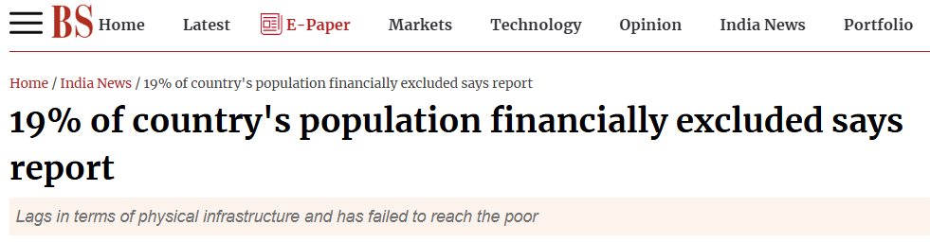
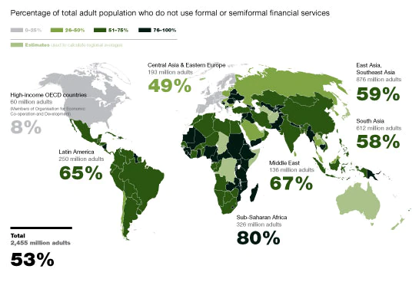

PROBLEM STATEMENT
HAPN
Global Financial Exclusion:
Over 1.7 billion people lack access to formal financial services, especially in remote and underserved areas.
Barriers:
High transaction costs, lack of physical banking infrastructure, low financial literacy, and regulatory hurdles.
Impact:
Financial exclusion perpetuates poverty, limits economic growth, and prevents individuals from accessing opportunities for financial stability.

Slide 4



SOLUTION
HAPN
Introducing
InFiConnect
Overview:
A secure and scalable FinTech platform designed to enhance financial inclusion.
Key Features:
Security: End-to-end encryption and AI-driven fraud detection.
Scalability: Cloud-based infrastructure with microservices architecture.
Inclusion: Alternative credit scoring, multilingual support, and offline functionality.
Impact: Provides equal access to financial services, empowering underserved communities with the tools they need for financial stability.

